Slide 1
RANDOM PASSWORD GENERATOR
NAME: M. Keerthana
ORGANIZATION: Micro IT
TOPIC: Random Password Generator

Slide 2
INTRODUCTION
The Random Password Generator is a software tool designed to create strong, unpredictable passwords automatically. With increasing concerns about online security, this project helps users generate passwords that are difficult to guess or crack, enhancing their account protection. The program typically allows customization of password length and character types, such as uppercase, lowercase, numbers, and special symbols, ensuring flexibility and security according to user needs.

Slide 3
OBJECTIVES OF THE PROJECT
To create secure and random passwords that are difficult to guess or hack.
To provide customizable options for password length and character types (letters, numbers, symbols).
To help users improve their online security by generating strong passwords easily.
To automate the password creation process, saving users time and effort.

Slide 4
WHAT IS RANDOM PASSWORD GENERATOR?
A Random Password Generator is a software tool or program that automatically creates passwords by selecting characters randomly. These passwords usually include a mix of uppercase letters, lowercase letters, numbers, and special symbols to make them strong and hard to guess. The main purpose is to help users generate secure passwords that protect their accounts from unauthorized access.

Slide 5
Types of Password Generators:
Random Password Generators Generate passwords by randomly picking characters from a set of letters, numbers, and symbols.
Pattern-Based Password Generators Create passwords based on predefined patterns or rules, like alternating letters and numbers.
Pronounceable Password Generators Generate passwords that are easier to remember and pronounce by using combinations that resemble words.
Passphrase Generators Create passwords made up of multiple random words to form a longer, easy-to-remember phrase.
Algorithmic Password Generators Use specific algorithms or formulas to generate passwords, sometimes based on user input like a master password.

Slide 6
Risk and Return Analysis
Risks:
Weak or predictable algorithm
Short/simple passwords
Insecure password storage
Poor user settings
Returns:
Strong and secure passwords
Saves time and effort
Encourages password uniqueness
Improves overall account safety

Slide 7
CONSTRUCTION OF RANDOM PASSWORD GENERATOR
Step 1: Include Libraries Use iostream, string, cstdlib, ctime, and cctype for input/output, randomization, and character processing.
Step 2: Define Character Sets Create strings for uppercase, lowercase, digits, and special characters.
Step 3: Collect User Preferences Ask the user for password length and which types of characters to include.

Slide 8
Step 4: Combine Selected Sets Build a pool of characters based on user input.
Step 5: Generate Password Randomly select characters from the pool and build the password.
Step 6: Display Output Print the generated password to the screen.

Slide 9
Tools Used
C++ Language – Core programming for logic and structure
Code Editor – e.g., Code::Blocks, Visual Studio, or any C++ IDE
Compiler – GCC or built-in compiler for code execution
Command Line / Terminal – For running and testing the program
Standard Libraries –
<iostream> for input/output
<string> for handling text
<cstdlib> and <ctime> for randomness
<cctype> for character checks

Slide 10
KEY LEARNINGS FROM THE INTERNSHIP
Practical Exposure: Gained hands-on experience applying theoretical knowledge to real-world problems.
Technical Skills: Improved proficiency in C++ programming, debugging, and code optimization.
Project Development: Learned the steps involved in building a complete software project (design, code, test, refine).
Problem-Solving: Enhanced logical thinking and troubleshooting skills during code development.
Time Management: Balanced multiple tasks and met deadlines efficiently.
Team Communication: Collaborated effectively with peers and mentors, improving professional communication.
Security Awareness: Understood the importance of secure password generation and user data protection.

Slide 11
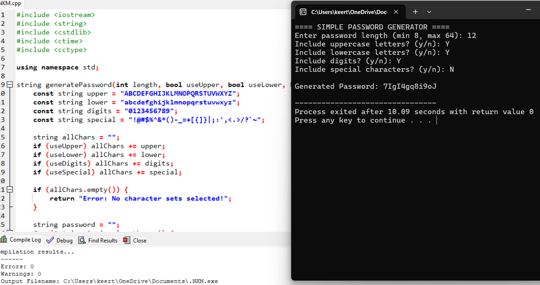

Slide 12
CONCLUSION
This internship provided valuable practical experience in software development, particularly in building secure systems like a random password generator. It strengthened my coding, problem solving, and project execution skills, bridging the gap between academic learning and real-world application.

Slide 13
THANK YOU

